Slide 1
Code vs Zombies:
OOD Meets Real-Time Strategy
Building Plants vs Zombies in Java for AI Agents

Slide 2
What if PvZ were designed
not just for players,
but also for intelligent agents?

Slide 3
Why Rebuild PvZ from Scratch?
Recreate original PvZ gameplay mechanics
Practice clean, modular OOP architecture
Enable AI-agent interaction through socket communication

Slide 4
Gameplay at a Glance
Lawn: 5 rows × 9 columns
Plant types: Attack, Defend, Generate
Zombies move forward in lanes
Collect sun to place units
Updates in real time

Slide 5
How We Built It
Java AWT(rendering) + Swing (GUI components)
MVC: GameState (Model), GameWindow (View), Game (Controller),
Agent Communication: Connector.java
Entity system: plants, zombies, projectiles, sun

Slide 6
Inside the Code: Plant Behavior
All plants inherit from Plant.java
Override action() method:
Sunflower: creates sun~15s
Peashooter: shoots pea
FreezePeashooter: slows zombies
Walnut: absorbs damage

Slide 7
Tracking Every Plant, Sun, and Zombie
Each lane stores: plants[5], zombies[5], projectiles[5]
Calls update() every frame:
Removes inactive entities
Manages sun score, cooldowns, signal when game is over

Slide 8
Bringing PvZ to Life with OOD
Encapsulation: Each entity manages itself
Inheritance: Shared logic in base classes
Polymorphism: update() and render() override
Composition: Game has GameState, InputHandler, Window, LevelManager
Abstraction: Reward/state exposed to agents only

Slide 9
What We Covered
Rebuilt PvZ logic using Java
Applied Object-Oriented Design (OOD) principles
Built a modular MVC architecture
Implemented real-time entity management
Enabled AI-agent control via socket interface

Slide 10
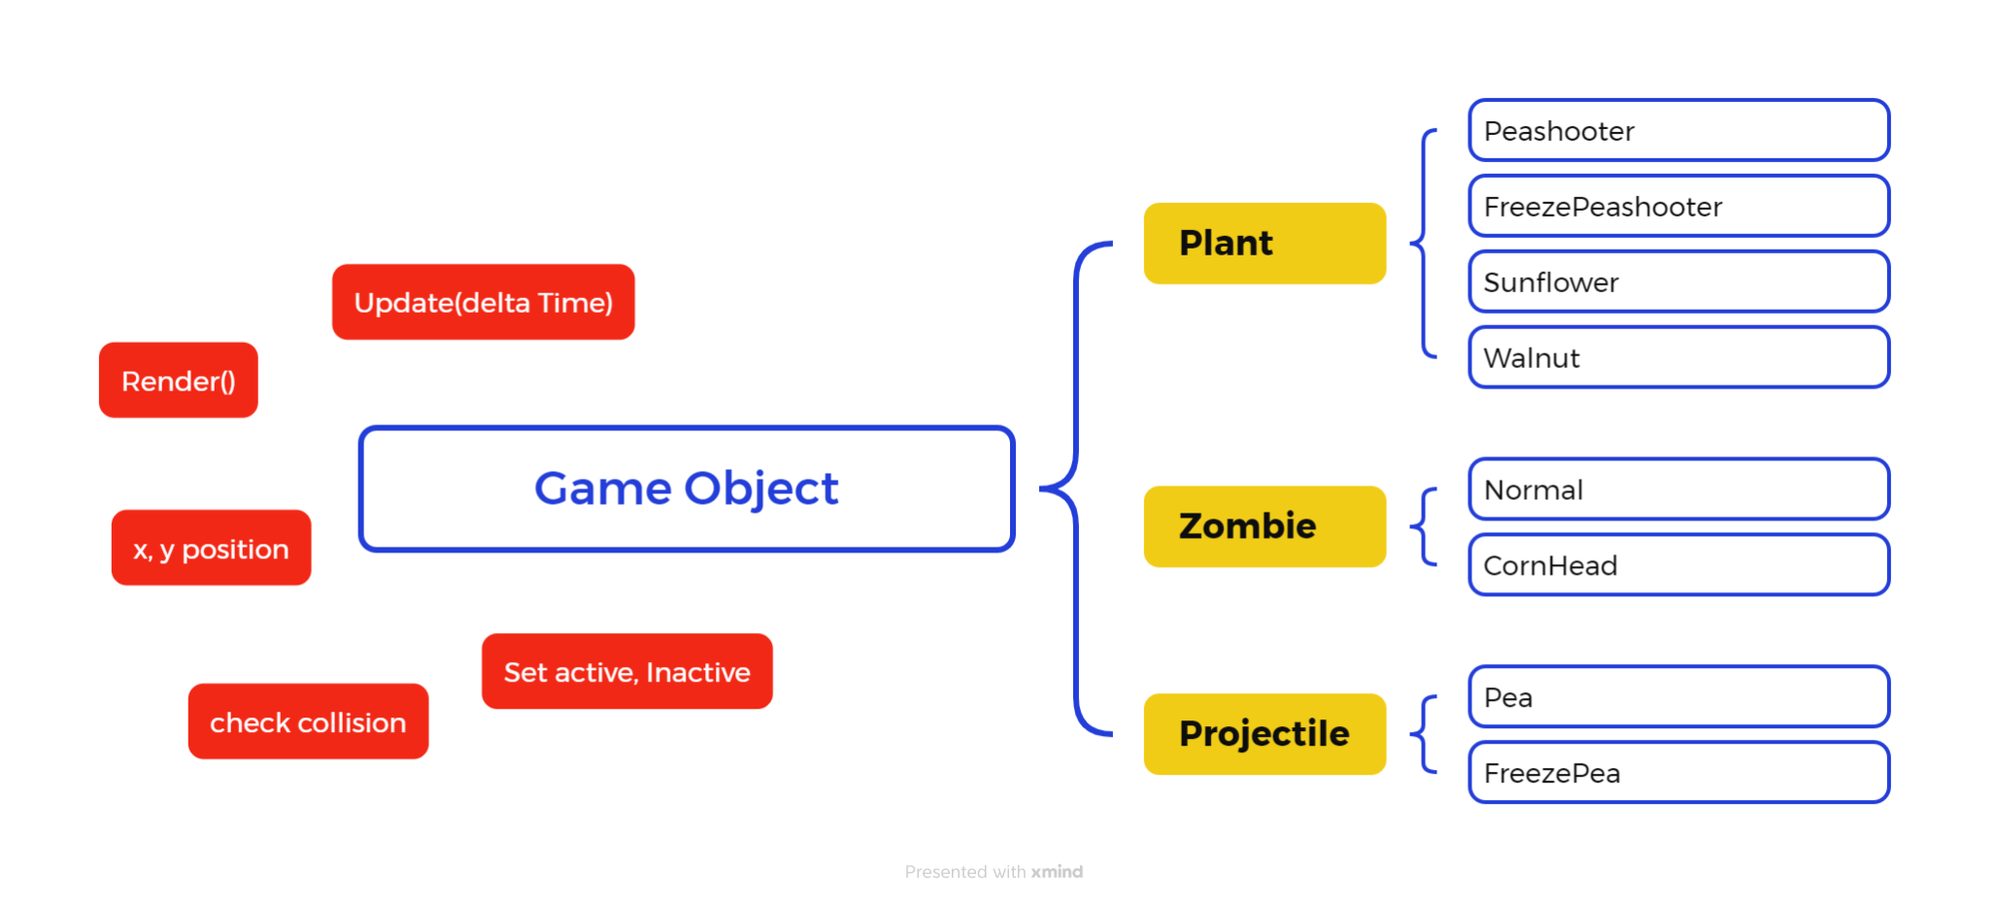
Implementation Details(Game Object)

Slide 11
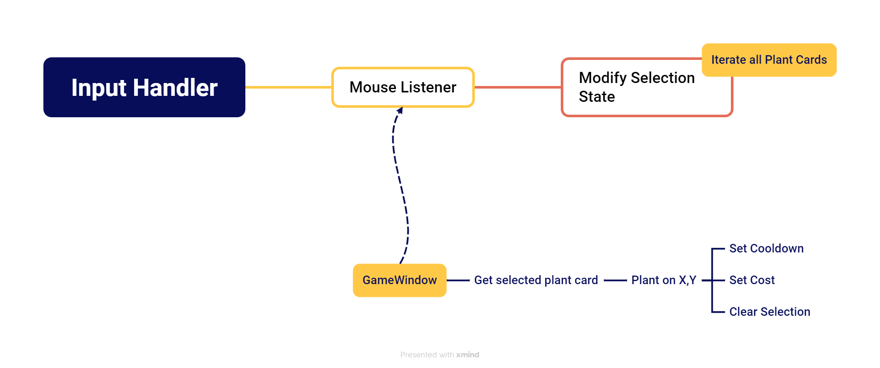
Implementation Details(Input handler)

Slide 12
Demo

